Slide 1
Mini project 3
Imran

Slide 2
Perform sentiment analysis using top comments from reddit posts on the playstation 5 (PS5)

Slide 3
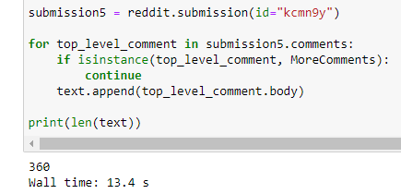
Reddit ps5 review threads
Obtained from 5 different reddit post on PS5 reviews

Slide 4
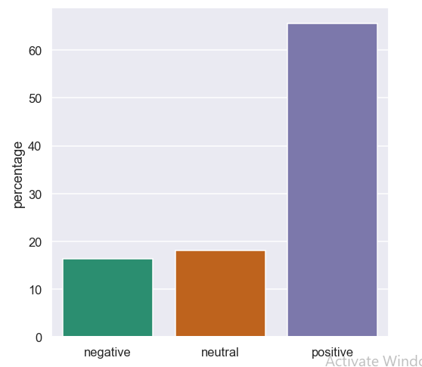
DATA – Vader

Slide 5
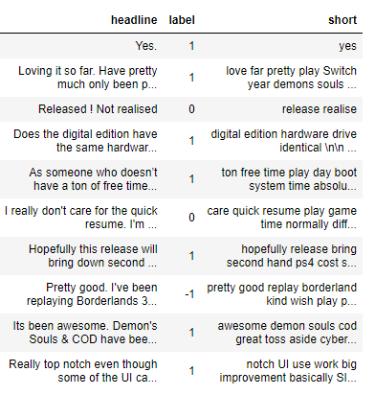
DATA – Vader
Removed StopWords, Punctuation and Lemmatize

Slide 6
Feature engineering
Count Vectors as features
TF-IDF Vectors as features
  Word level
  N-Gram level
  Character level

Slide 7
Models
Naive Bayes Classifier
Support Vector Machine
Random Forest Classifier
Gradient Boosting

Slide 8
Models
Naive Bayes Classifier
kNN
Support Vector Machine
Random Forest Classifier
Gradient Boosting

Slide 9
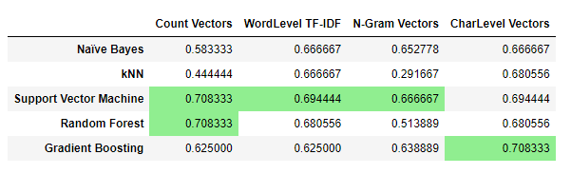
Accuracy scores
SVM and Random Forest (Count Vectors) had the best scores
Gradient Boosting (CharLevel Vectors) had a similarly good score.
kNN was the worst performer

Slide 10
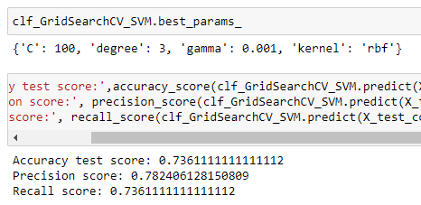
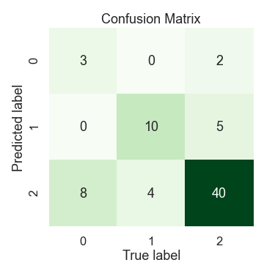
SVM (tuned)
SVM (tuned)
Increase in accuracy by 3%
Precision 78%
Recall 74%

Slide 11
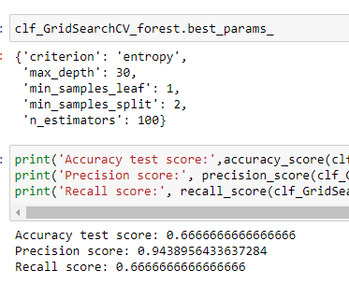
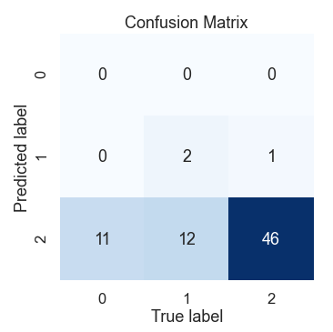
Random forest (tuned)
Decrease in accuracy by 3%
Precision 94%
Recall 67%

Slide 12
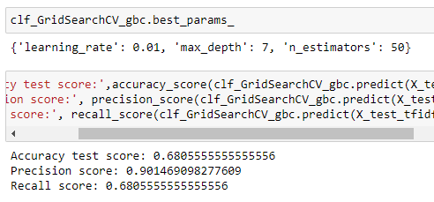
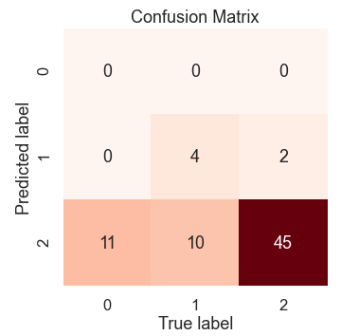
Gradient boosting (tuned)
Decrease in accuracy by 2%
Precision 90%
Recall 68%

Slide 13
conclusion
SVM (Tuned) is the best performing model
Other considerations:
  Obtaining more reddit comments from more reviews
  Consider the accuracy of using VADER for labelling

Slide 14
The end

